Slide 1
Global Linear and Local Superlinear Convergence of IRLS for Robust Regression
@ NeurIPS 2022
Liangzu Peng ⃰ Christian Kümmerle° René Vidal ⃰
⃰ : Mathematical Institute for Data Science, Johns Hopkins University
°: Department of Computer Science, University of North Carolina at Charlotte

Slide 2
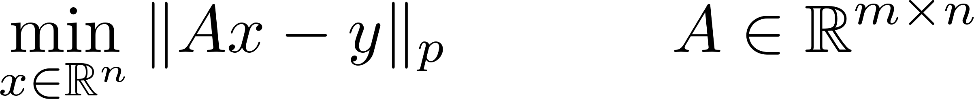
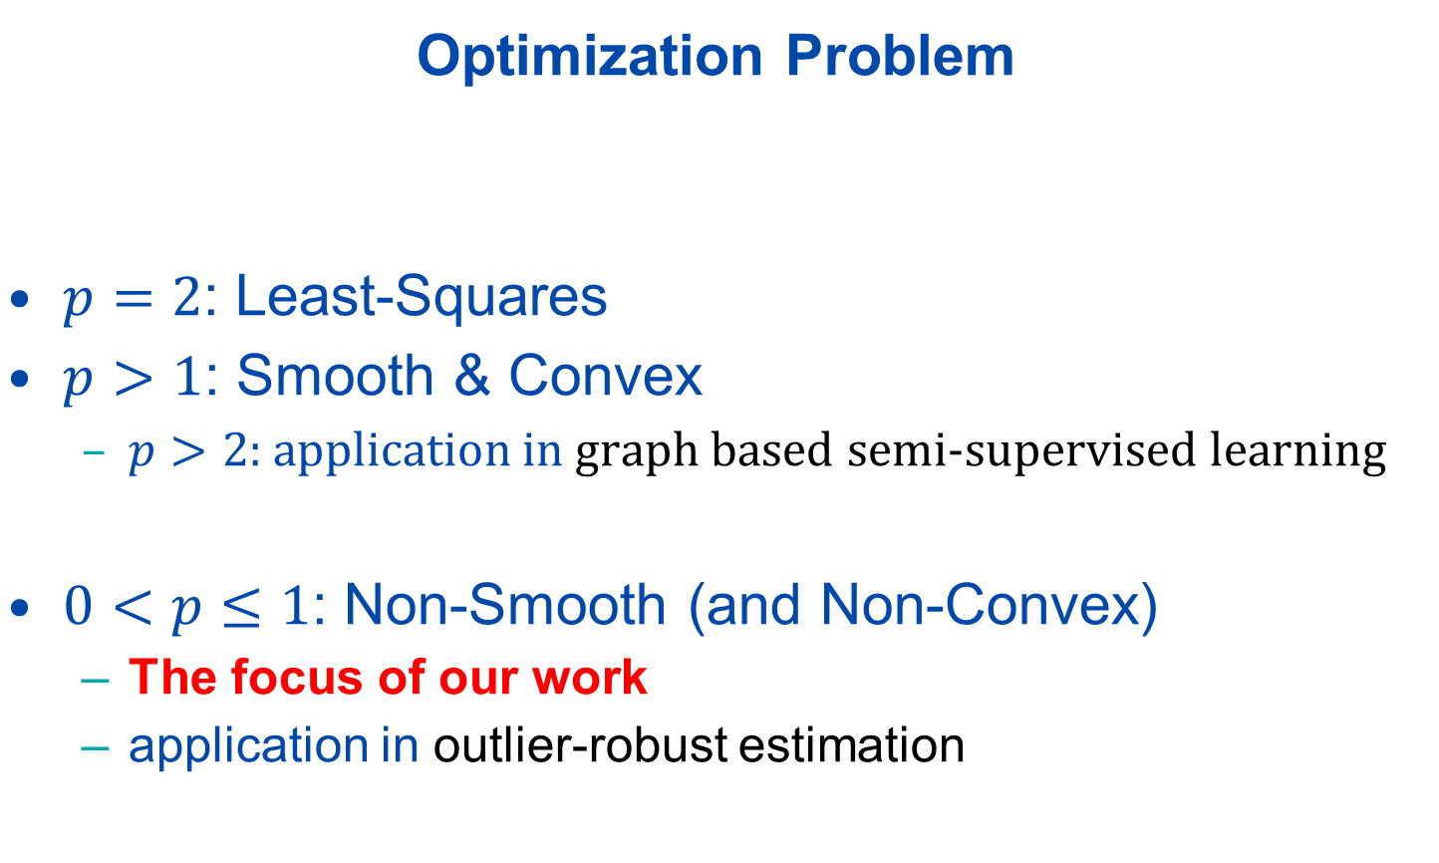

(Robust) Linear Regression
Optimization Problem
$p=2$: Least-Squares
$p>1$: Smooth & Convex
$p>2$: application in graph based semi-supervised learning
$0<p≤1$: Non-Smooth (and Non-Convex)
The focus of our work
application in outlier-robust estimation
($l_{p}$-Regression)

Slide 3


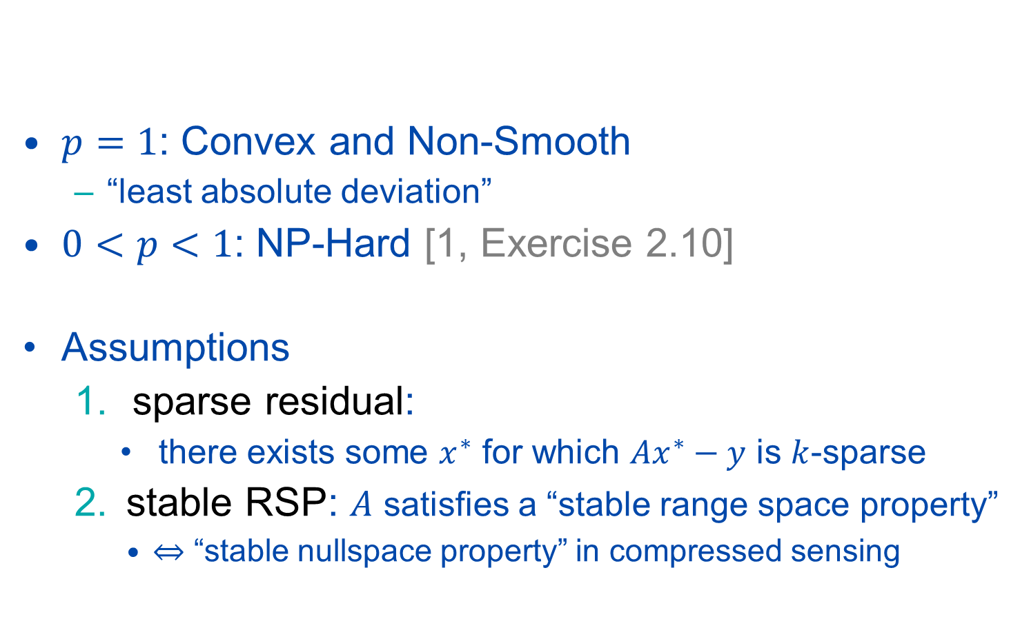
Non-Smooth Robust Regression: $0<p≤1$
$p=1$: Convex and Non-Smooth
“least absolute deviation”
$0<p<1$: NP-Hard [1, Exercise 2.10]
Assumptions
sparse residual:
there exists some $x^{∗}$ for which $Ax^{∗}−y$ is $k$-sparse
stable RSP: $A$ satisfies a “stable range space property”
“stable nullspace property” in compressed sensing
($l_{p}$-Regression)
[1] S. Foucart and H. Rauhut, “A Mathematical Introduction to Compressive Sensing. Springer”, 2013.

Slide 4
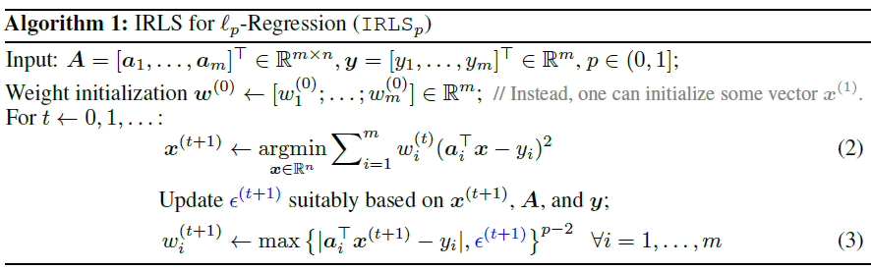

Iteratively Reweighted Least-Squares (IRLS)
Basic Idea of ${IRLS}_{p}$
alternates between least-squares (2) & weight update (3)
${IRLS}_{p}$ variants differ in how $ε^{(t)}$ is updated
($l_{p}$-Regression)

Slide 5
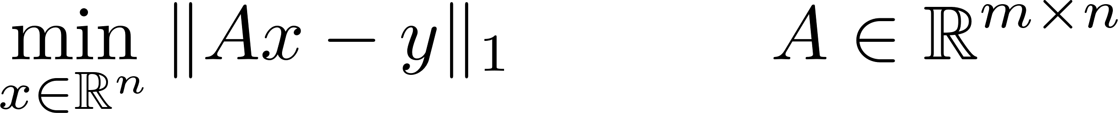



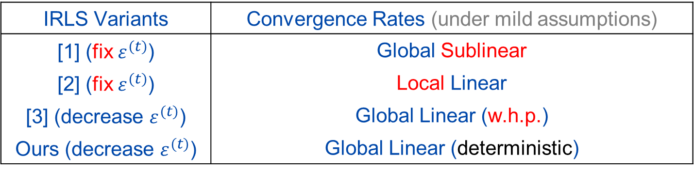

Contribution #1: ($p=1$)
Message 1:
decreasing $ε^{(t)}$ per iter. stronger theoretical guarantees
($l_{1}$-Regression)
IRLS Variants | Convergence Rates (under mild assumptions)
[1] (fix $ε^{(t)}$) | Global Sublinear
[2] (fix $ε^{(t)}$) | Local Linear
[3] (decrease $ε^{(t)}$) | Global Linear (w.h.p.)
Ours (decrease $ε^{(t)}$) | Global Linear (deterministic)
[1] A. Beck, “On the convergence of alternating minimization for convex programming with applications to iteratively reweighted least squares and decomposition schemes”, SIAM J. Optim., 2015.
[2] T.F. Chan & P. Mulet, “On the convergence of the lagged diffusivity fixed point method in total variation image restoration”, SIAM J. Numer. Anal., 1999
[3] B. Mukhoty, G. Gopakumar, P. Jain, and P. Kar, “Globally-convergent iteratively reweighted least squares for robust regression problems”, AISTATS 2019.

Slide 6
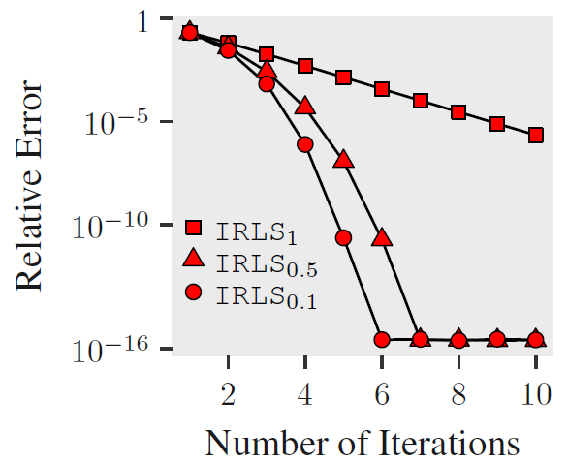
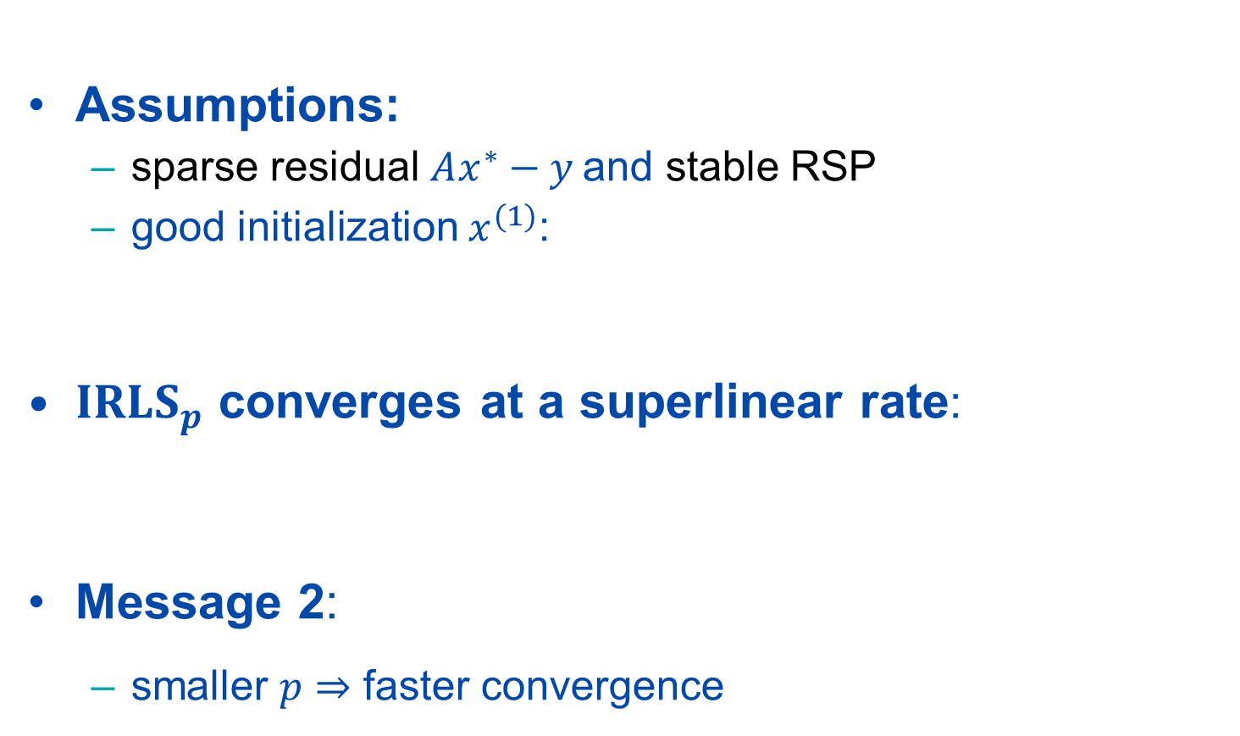

Contribution #2: ($0<p<1$)
Assumptions:
sparse residual $Ax^{∗}−y$and stable RSP
good initialization $x^{(1)}$:
${IRLS}_{p}$ converges at a superlinear rate:
Message 2:
smaller $p$ faster convergence
($l_{p}$-Regression)

Slide 7
More Information
This work was supported by grants NSF 1704458, NSF 1934979, and NSF 2031985
Vision Lab @ JHU http://www.vision.jhu.edu
Center for Imaging Science @ JHU http://www.cis.jhu.edu
Mathematical Institute for Data Science @ JHU http://www.minds.jhu.edu
Thank You!

